Slide 1
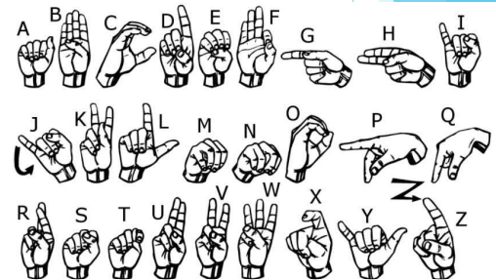
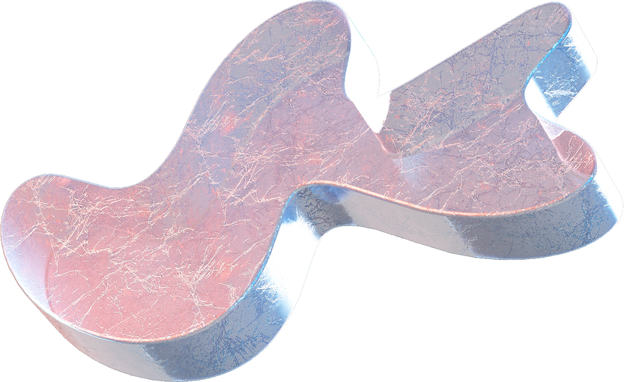
AI_Sign Language Recognition

Slide 2

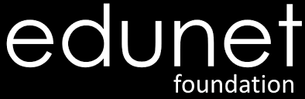
ABOUT ORGANIZATION
Edunet Foundation is a non-profit organization that works to improve the quality of education and provide employment opportunities for underprivileged youth in India. IBM SkillsBuild is a free online learning platform that offers courses in technology and professional skills. Edunet Foundation is the IBM partner for SkillsBuild in India.
The IBM SkillsBuild internship is brought to you by the Edunet Foundation.
Access to IBM SkillsBuild e-Learning Platform with over 80,000 curated courses on technical and professional skills.
Learners can experience masterclasses led by Subject Matter Experts

Slide 3
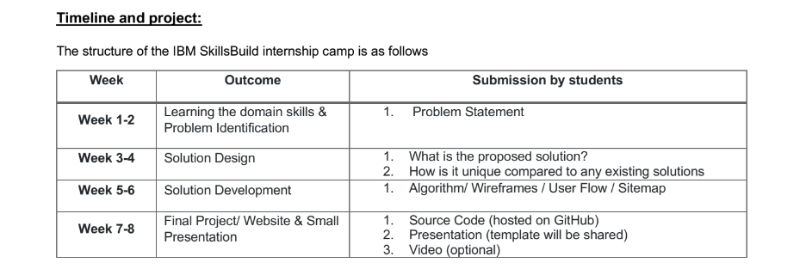

Slide 4
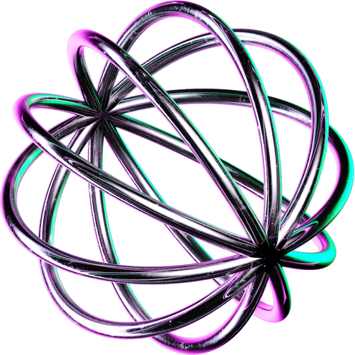
PROBLEM STATMENT
Given a hand gesture, implementing such an application that detects sign language in real time through hand gestures and allowing the user to get the accurate values of the result of the character detected in a live video taken as well as allowing such users to build their customised gesture so that the problems faced by people who are unable to talk vocally can be accommodated with technological assistance and the barrier of expression can be overcome. This motivated me to work for the project.

Slide 5
PROJECT OVERVIEW
We created one database of images of alphabets A to Z (26 folders). Each alphabet folder has 101 images.
After that we created one model using machine learning algorithm.
Then, we trained all images using the model.
After training part is done, testing is required. So from live video, we will be testing signs.
Accordingly, we will get the name of the signs along with the accuracies on the side of the box.

Slide 6
WHO ARE THE END USERS
It is most commonly used by deaf & dumb people who have hearing or talking disorders to communicate among themselves.
Even normal people can use this to communicate with the deaf and dumb people.

Slide 7
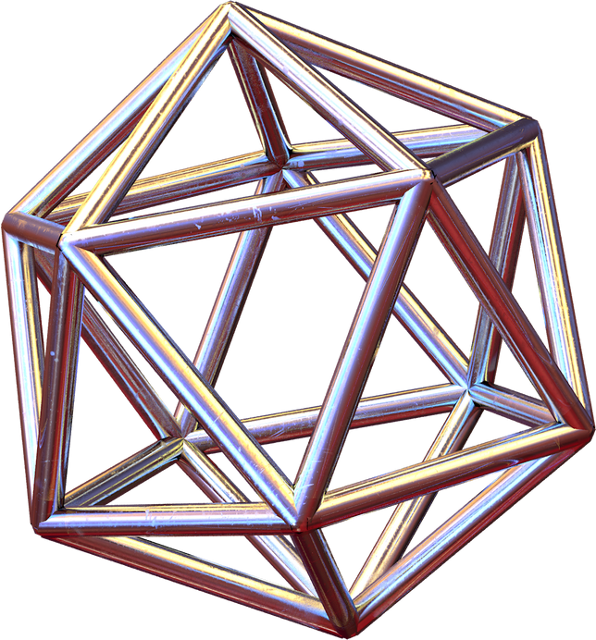
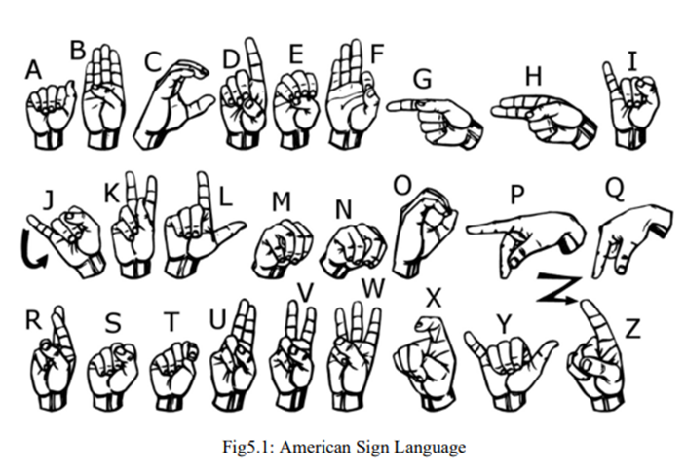

DATASET USED

Slide 8
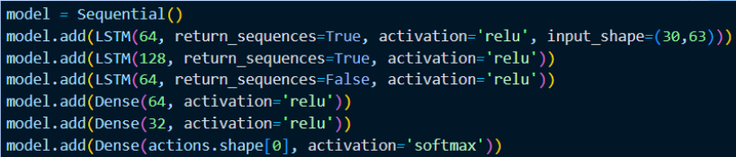
MODEL
LSTM networks are well-suited to classifying, processing and making predictions based on time series data, since there can be lags of unknown duration between important events in a time series. LSTMs were developed to deal with the vanishing gradient problem that can be encountered when training traditional RNN.

Slide 9
ALPHABETS | ACCURACY | ALPHABETS | ACCURACY | ALPHABETS | ACCURACY
A | 91.95% | J | 82.94 | S | 89.21%
B | 99.47% | K | 90.88% | T | 99.99%
C | 82.21% | L | 80.89% | U | 89.25%
D | 99.98% | M | 100% | V | 100%
E | 98.73% | N | 99.65% | W | 85.16%
F | 87.45% | O | 100% | X | 95.69%
G | 99.99% | P | 99.18% | Y | 99.96%
H | 99.98% | Q | 100% | Z | 99.99%
I | 90.49% | R | 99.99% | SOME ALPHABETS HAVING PROBLEM IN ACCURACY | SOME ALPHABETS HAVING PROBLEM IN ACCURACY
RESULTS

Slide 10
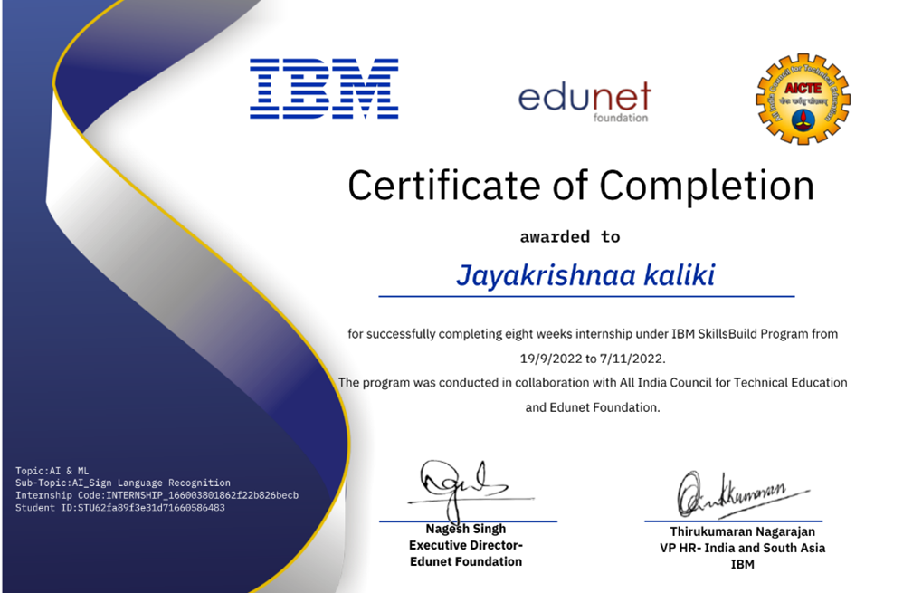

Slide 11
THANK YOU

Slide 12
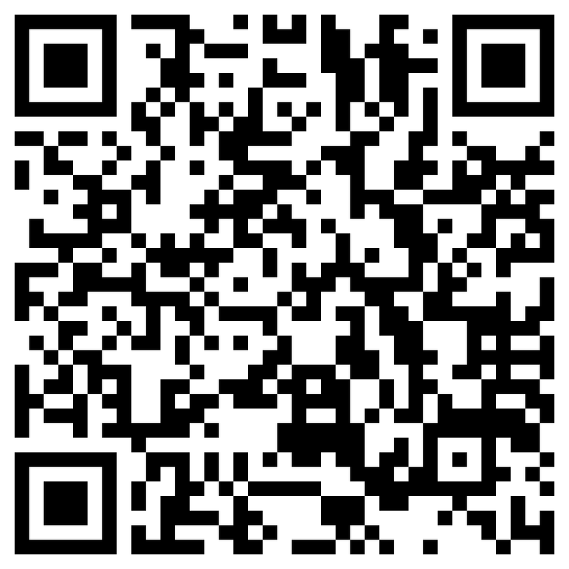
Scan For Review
Jayakrishnaa Kaliki
122010322016

